Slide 1
Concurrency — Exercise 6
Rust II

Slide 2
Problem 1 Implement the banking example from the lecture in Rust

Slide 3
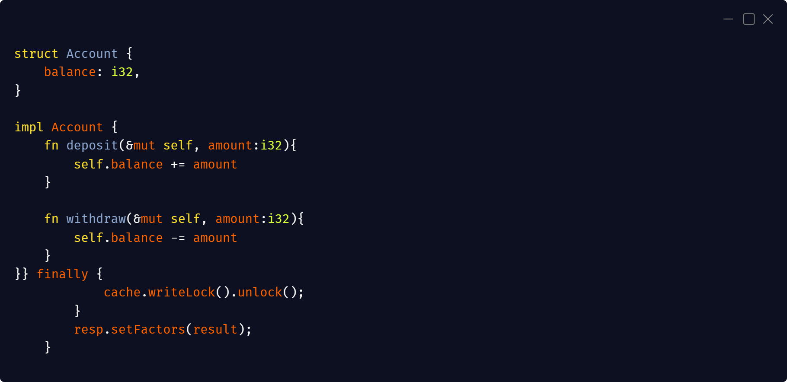

Slide 4
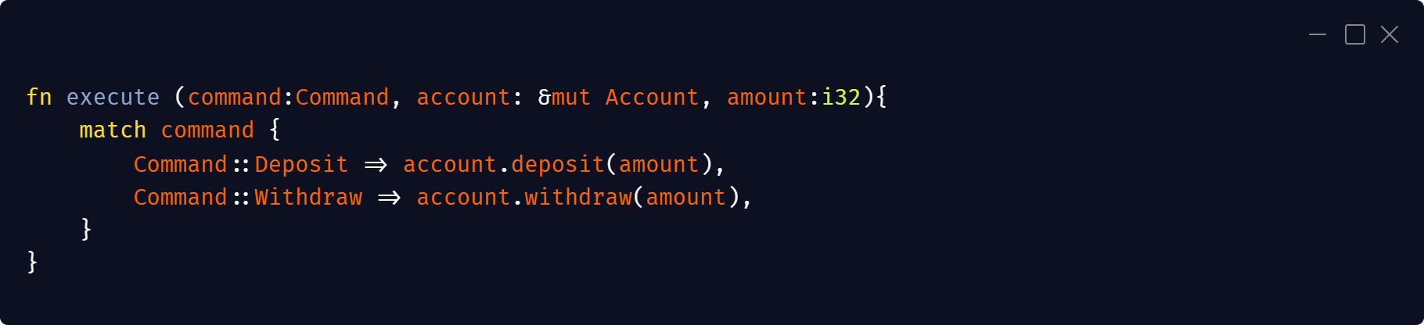

Slide 5
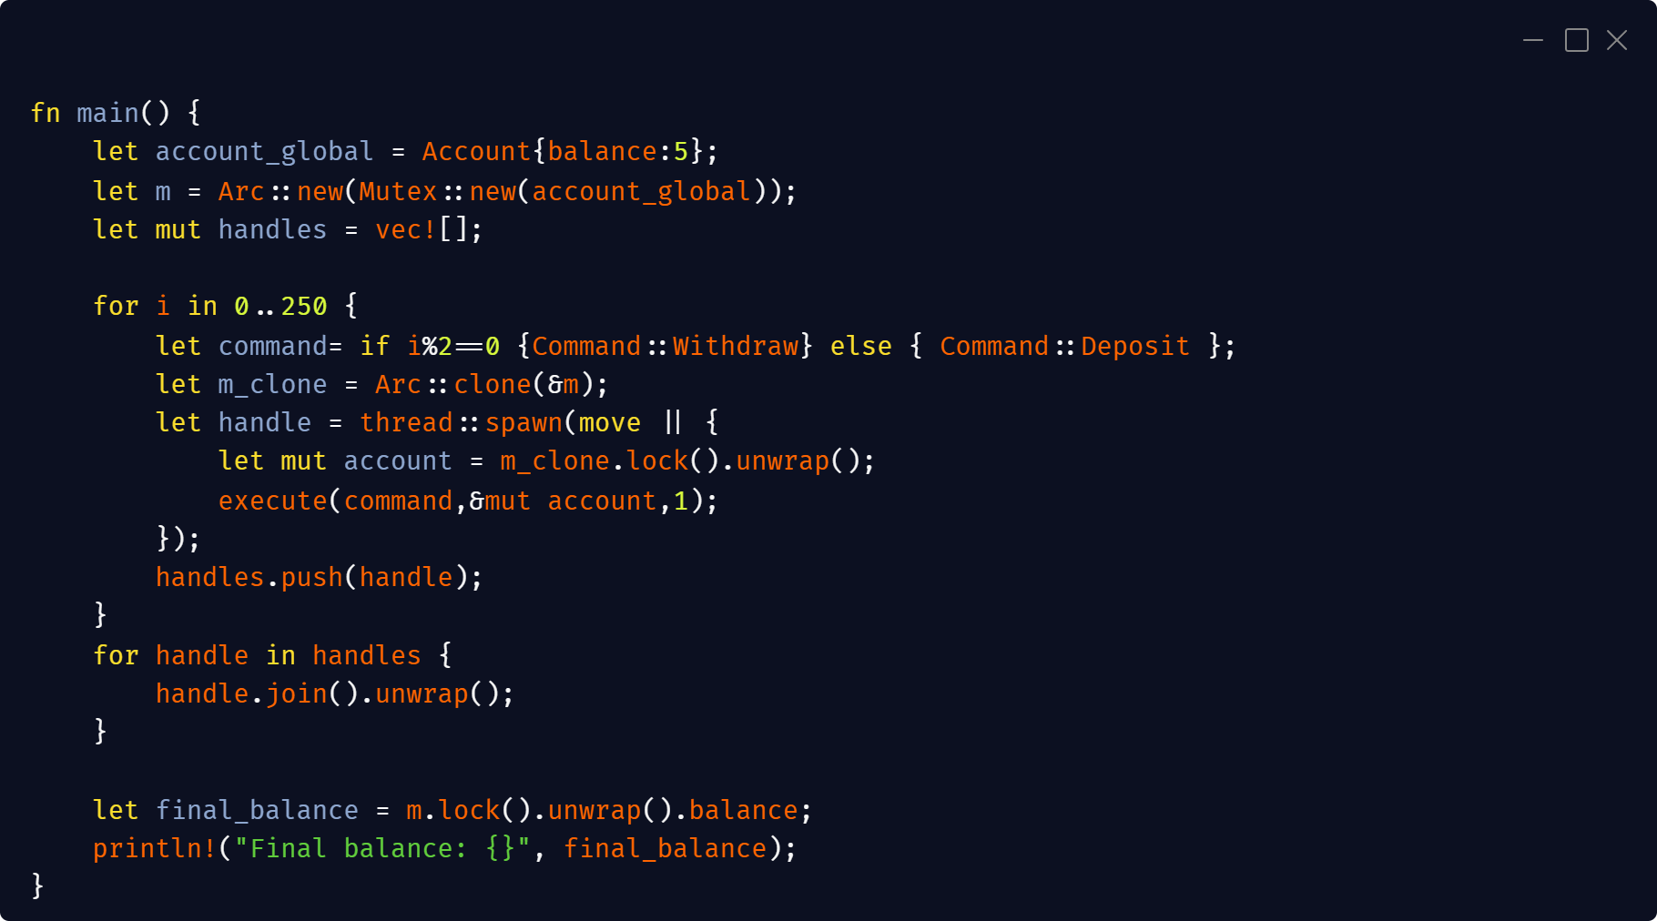

Slide 6
Problem 2 implement the factorizer service from exercise 4 as a struct

Slide 7
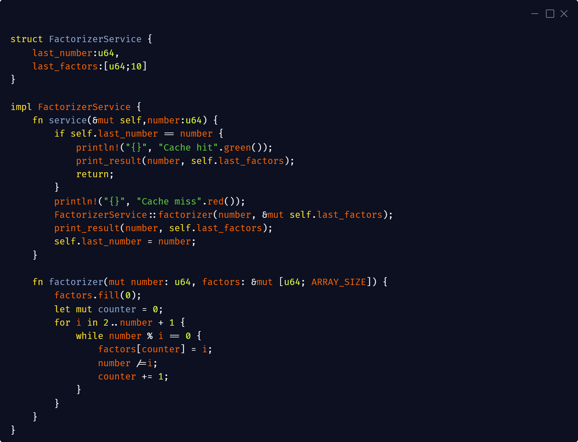

Slide 8
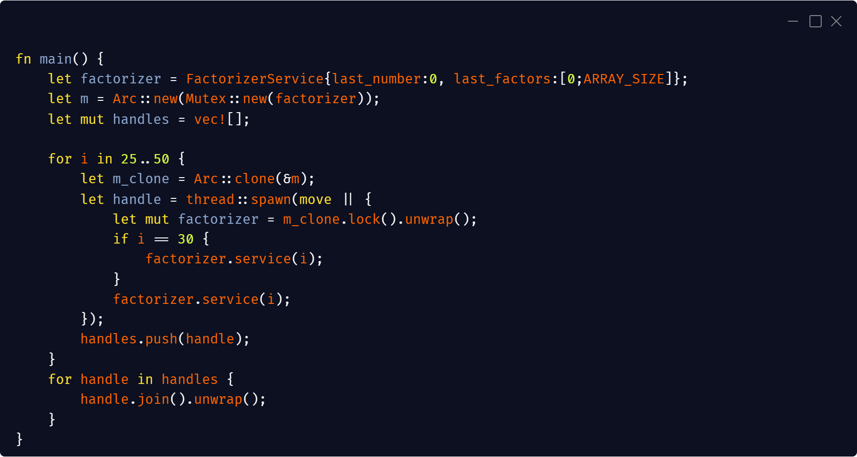

Slide 9
Problem 3 Modify the solution from problem 2 such that the computation of the factors does not happen in the critical region

Slide 10
